Slide 1
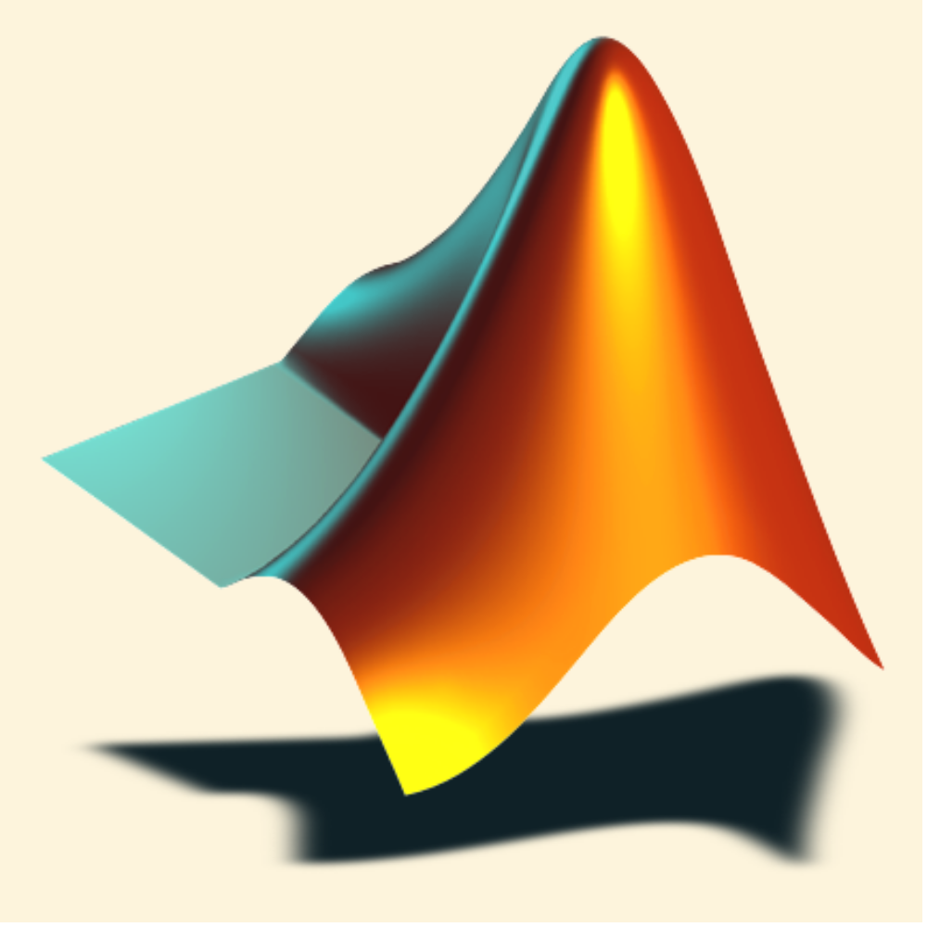
Introduction to MATLAB
Basic Graphics
The MathWorks Inc.
Natick, MA
USA

Slide 2
Section Outline
2-D Plotting
Graph Annotation
Interpolation & Curve Fitting
Subplots
Alternative Axes
3-D Plotting
Specialized Plotting Routines
Saving & Exporting Figures
Introduction to Handle Graphics
Ref: Special characters using LaTeX
Notes:
Basic Graphics
2-D Plotting
Graph Annotation
Interpolation & Curve Fitting
Subplots
Alternative Axes
3-D Plotting
Specialized Plotting Routines
Saving & Exporting Figures
Introduction to Handle Graphics
In this section we will introduce some of the basic graphics functions of MATLAB.

Slide 3
2-D Plotting
Specify x-data and/or y-data
Specify color, line style and marker symbol
(Default values used if ‘clm’ not specified)
Syntax:
  Plotting single line:
  Plotting multiple lines:
plot(xdata, ydata, 'color_linestyle_marker')
plot(x1, y1, 'clm1', x2, y2, 'clm2', ...)
Notes:
2-D Plotting
Ploting a single line:
plot(xdata, ydata, 'clm')
Plotting multiple lines:
plot(x1, y1, 'clm1', x2, y2, 'clm2', ...)
The plot function is used to produce two-dimensional
curves, using x- and y-data matrices specified by the user.
If not otherwise specified, a blue solid line, without marker symbols, is produced.
However, plot also accepts character-string arguments that designate various colors, line styles, and marker symbols for the resulting line. For example, to produce a red dotted line with square markers at each data point, type
>> plot(x,y,'r:square')
You can plot multiple lines at once, using pairs of x- and y-data, or triples of x, y, and the color, line style, and marker information. If not specified, MATLAB automatically cycles through a predefined (but user-settable) list of colors to identify each line. For example, the following statement plots three lines as a function of t (First = blue / Second = green / Third = red).
>> plot(t, y1, t, y2, t, y3)
The color, linestyle and marker type is a character string made from one element from any or all the following three columns.
y yellow . point - solid
m magenta o circle : dotted
c cyan x x-mark -. dashdot
r red + plus -- dashed
g green * star
b blue s square
w white d diamond
k black v triangle (down)
^ triangle (up)
< triangle (left)
> triangle (right)
p pentagram
h hexagram
comet - produces comet-like trajectory of 2-D data points.
Try:
>> help plot
>> x = -5:5;
>> y = x.^2;
>> plot(x,y,’r:s’)

Slide 4
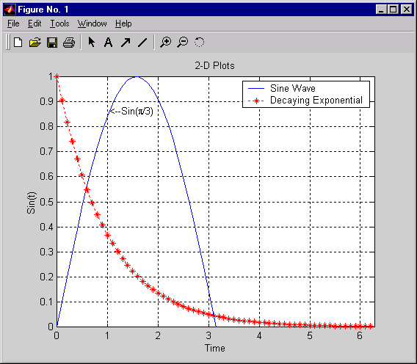
Graphics Example (final product)
TITLE
LEGEND
TEXT
or
GTEXT
YLABEL
CURVES
XLABEL
Notes:
Graphics Example
(final product)
In the next few pages, we will create this figure. Follow along with the commands listed to the right under Try:

Slide 5
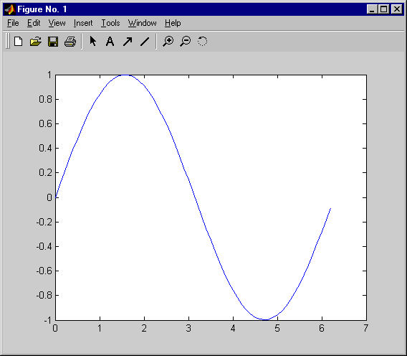
2-D Plotting - example
Create a Blue Sine Wave
>> x = 0:.1:2*pi;
>> y = sin(x);
>> plot(x,y)
>> plot_2d
Notes:
Try:
>> x = 0:.1:2*pi;
>> y = sin(x);
>> plot(x,y)
Create a Blue Sine Wave
In this example, the data plotted along the x-axis is defined as
>> x = 0:0.1:2*pi;
The data plotted along the y-axis is defined as
>> y = sin(x);
Plot the data as follows ( the default is a blue, solid line, no marker).
>> plot(x,y)

Slide 6

Adding a Grid
GRID ON creates a grid on the current figure
GRID OFF turns off the grid from the current figure
GRID toggles the grid state
>> grid on
Notes:
Try:
>> help grid
>> grid on
Adding a Grid
grid on creates a grid on the current figure.
>> grid on
grid off turns off the grid from the current figure.
>> grid off
grid toggles the grid state.
>> grid

Slide 7
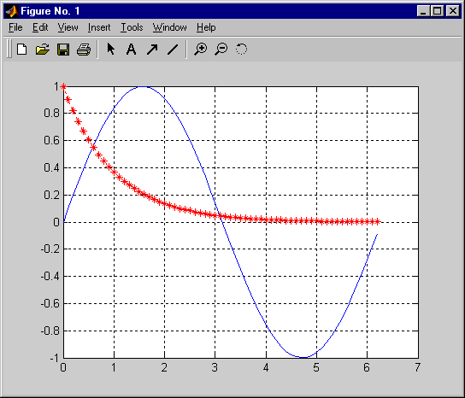
Adding Additional Plots to a Figure
HOLD ON holds the current plot
HOLD OFF releases hold on current plot
HOLD toggles the hold state
>> x = 0:.1:2*pi;
>> y = sin(x);
>> plot(x,y)
>> grid on
>> hold on
>> plot(x,exp(-x),'r:*')
>> addgraph
Notes:
See:
Using MATLAB Graphics
Pages: 2-9
Try:
>> x = 0:.1:2*pi;
>> y = sin(x);
>> plot(x,y)
>> grid on
>> hold on
>> plot(x, ...
exp(-x),'r:*')
Adding Additional Plots to a
Figure
hold on holds
the current plot.
>> hold on
hold off releases
hold on current plot.
>> hold off
hold toggles the
hold state.
>> hold
By default, plot deletes existing lines and resets all axis properties when a new line is drawn (hold off).
To add lines to an existing plot, turn hold on. In this mode, MATLAB does not remove the existing graph but adds new lines to the current plot. If the new data falls outside the range of the original axes, MATLAB will rescale the axes accordingly.
When you set hold off, the default mode is restored. The plot command erases any existing plots and resets all axis properties before creating new plots.
When you call hold, by itself, the hold state is toggled.
If you do not want MATLAB to rescale the axes, issue the command axis manual before you plot your second set of data.

Slide 8
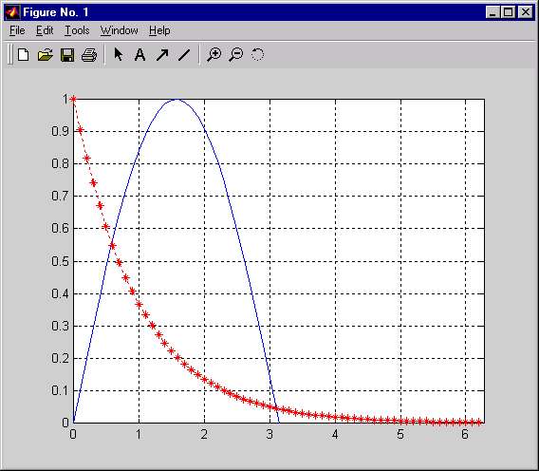
Controlling Viewing Area
ZOOM using the figure toolbar
From the command line:
ZOOM ON allows user to select viewing area
ZOOM OFF prevents zooming operations
ZOOM toggles the zoom state
AXIS sets axis range
[xmin xmax ymin ymax]
>> axis([0 2*pi 0 1])
Notes:
Controlling Viewing Area
Zoom using
the figure toolbar
Left mouse button
zoom in (x2)
Right button
zoom out (x1/2)
double-click Left
zoom out completely
You can also activate the zoom property from the command line using the zoom command. Type >> help zoom for more information.
The axis command is used to set the absolute range of the viewing area.
>> axis([0 2*pi 0 1])
In addition, it can accept specific arguments to perform common axis manipulations, for example.,
axis auto returns the axis scaling to its default, automatic mode.
axis manual freezes the scaling at the current limits.
axis ij puts MATLAB into its "matrix" axes mode (origin in top-left corner).
axis xy puts MATLAB into its default "Cartesian" axes mode.
axis equal sets the aspect ratio for equal tick mark increments on the x-,y- and z-axes.
axis square makes the current axis box square in size.
axis normal restores the current axis box to full size (Undoes square / equal).
axis off turns off all axis labeling, tick marks and background.
axis on turns axis labeling, tick marks and background back on.
>> help zoom
>> zoom on
>> zoom off
>> zoom
>> help axis
Try:
>> zoom on
% click on the plot
% to zoom, then set
% the area exactly
>>axis([0 2*pi 0 1])

Slide 9
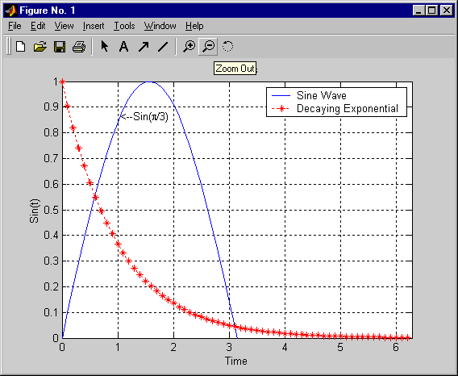
Graph Annotation
>> title('2-D Plots')
>> xlabel('Time')
>> ylabel('Sin(t)')
>> text(pi/3,sin(pi/3),...
'<--Sin(\pi/3)')
>> legend('Sine Wave', ...
'Decaying Exponential')
>> annotation
Notes:
See:
Using MATLAB Graphics
Pages:
2-19 - 2-21
Try:
>> title( ...
'2-D Plots')
>> xlabel('Time')
>> ylabel('Sin(t)')
>> text(pi/3,...
sin(pi/3), ...
‘<--Sin(\pi/3)’)
>> legend( ...
‘Sine Wave’, ...
[‘Decaying’ ...
‘Exponential’])
Graph Annotation
MATLAB provides various commands for annotating your graph.
These commands include:
title - adds a title to the graph
xlabel - adds a label to the x-axis
ylabel - adds a label to the y-axis
The title, xlabel, and ylabel commands automatically position the text strings appropriately on your graph.
text - adds a text string at a specified location on the plot. It also allows you to specify the color and alignment of the string.
gtext - allows you to interactively place a text string on your graph. It accepts a string as an argument and waits while you select a location on the graph with the mouse. MATLAB then displays the text string at the indicated location. gtext is a convenient way to annotate your graph if you want precise positioning of the text, however it only works on two-dimensional graphs.
Another similar (and very useful) command:
ginput - allows you to pick off the co-ordinates of points from a graph. Click on a point to record its location, press Enter to return to the command line.

Slide 10
Special Graph Annotations (TeX)
Superscript and subscript:
  ^{super} and _{sub}
Appearance:
Some boldface and some italics
Greek characters:
y = e^{αx}sin(βx)
Annotations apply inside {}, until changed, or removed ( \rm )
>> xlabel('^{super} and _{sub}')
>> ylabel('Some \bfboldface\rm and some {\ititalics}')
>> text(3.5, 20, 'y = e^{\alphax}sin(\betax)')
>> latex_examp
Ref: Special characters using LaTeX
Notes:
Special Graph Annotations (TeX)
MATLAB supports a subset of LaTeX commands to
control the appearance of graph annotations. For example,
Effects:
>> xlabel('^{super} and _{sub}')
^{super} and _{sub}
Font Style:
>> ylabel('Some \bfboldface\rm and some \it{italics}')
Some boldface and some italics
Greek Characters:
>> text(3.5, 20,'y = e^{\alphax}sin(\betax)')
y = e^{α}xsin(βx)
Font Type:
>> title('\fontname{Times}{Times}\fontname{Impact}{Impact}')
Times Impact
To view these annotations on an appropriate graph, type
>> latex_examp
You can also use the Symbol font to create many special characters.
>> latex_examp
>> doc text_props
% refer to the
% string property
Ref: Special characters using LaTeX

Slide 11
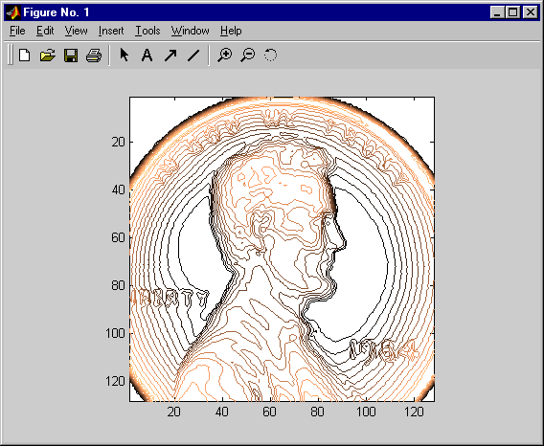
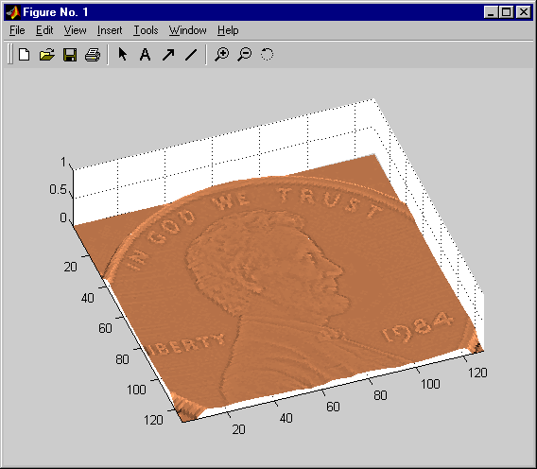
Plot Editor Toolbar
>> penny
%Use the zoom buttons then
%Press Enter to continue ...
%Use the rotate tool then
%Press Enter to continue ...
>> penny
%Use the zoom buttons then
%Press Enter to continue ...
Notes:
The Plot Editor has the following buttons:
The Plot Editor also enables right-click capabilities. By right-clicking on any part of the figure, a context menu will appear that allows the user to change properties of the figure, axes, plot, etc.
All tools that can be used by clicking a button, or right-clicking on the figure, can be accessed from the Tools pull-down menu.
>> penny
%Use the zoom
%buttons; then
%press Enter to
%continue ...
%Use the rotate
%tool; then press
%Enter to
%continue ...
>> penny
>> doc plotedit

Slide 12
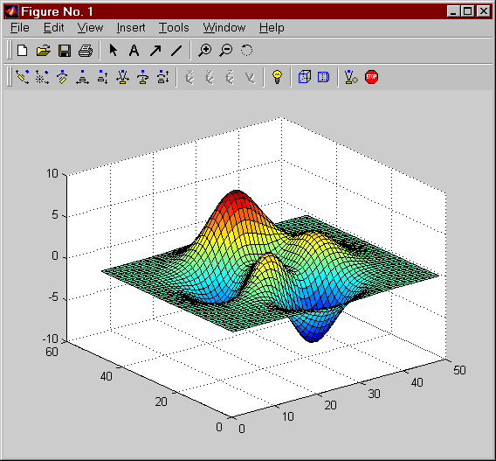
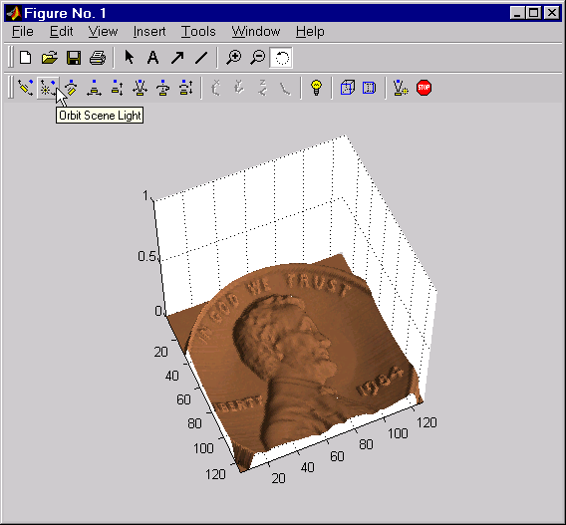
Camera Toolbar
Stop Camera/Light Motion
Reset Camera and Scene Lighting
Perspective Projection
Orthographic Projection
Toggle Scene Light
No Principal Axis
Principal Axis Z
Principal Axis Y
Principal Axis X
Walk Camera
Roll Camera
Zoom Camera
Move Camera Forward/Back
Move Camera Horizontally/Vertically
Pan/Tilt Camera
Orbit Scene Light
Orbit Camera
Notes:
Camera Toolbar
The Camera Toolbar enables you to perform a number of
viewing operations interactively.
To use the Camera Toolbar:
. Display the toolbar by selecting Camera Toolbar from the
figure window's View menu.
. Select the type of camera motion control you want to use.
. Position the cursor over the figure window and click, hold down he right mouse button, and then move the cursor in the desired direction.
MATLAB updates the display immediately as you move the mouse.

Slide 13
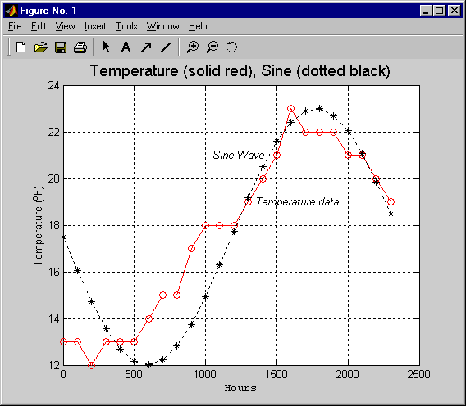
Exercise 3.1: 2-D Plotting
Create the following graph (first load data):
  >> load temperature
fontsize (14)
Temperature
Data
17.5 + 5.5*(sin(.5*time))
Courier New
Notes:
Exercise 3.1: 2-D Plotting
Create the following graph.
Remember to load the temperature data.
>> load temperature
Extra Credit
After creating the above plot, try to modify the fitted curve to find a better fit if possible.
First:
>> load temperature

Slide 14
Solution appears on following page.
Notes:
Solution appears on following page.

Slide 15
Solution 3.1: 2-D Plotting
>> plot(time, temp, 'ro-')
>> hold on
>> y = 17.5 + 5.5*sin(.5*time);
>> plot(time, y, 'k*:')
>> xlabel('\fontname{courier new}{Hours}')
>> ylabel('Temperature (^oF)')
>> title('\fontsize{14}{Temperature (solid red), Sine (dotted black)}')
>> text(1350,19,'\it{Temperature data}')
>> text(1050,21,'\it{Sine Wave}')
% NOTE: Could have also used GTEXT or the PLOT EDITOR:
% ====================================================
% gtext('\it{Temperature data}');
% gtext('\it{Sine Wave}');
>> plot2d_soln
Notes:
Solution 3.1: 2-D Plotting
>> plot(time, temp, 'ro-')
>> hold on
>> y = 17.5 + 5.5*sin(.5*time);
>> plot(time, y, 'k*:')
>> xlabel('\fontname{courier new}{Hours}')
>> ylabel('Temperature (^oF)')
>> title(['\fontsize{14}’ ...
‘{Temperature (solid red), Sine (dotted black)}’])
>> text(1350,19,'\it{Temperature data}')
>> text(1050,21,'\it{Sine Wave}')
% NOTE: Could have also used GTEXT or PLOT EDITOR:
% ===========================================
% gtext('\it{Temperature data}');
% gtext('\it{Sine Wave}');
Try:
>> edit plot2d_soln
>> plot2d_soln

Slide 16
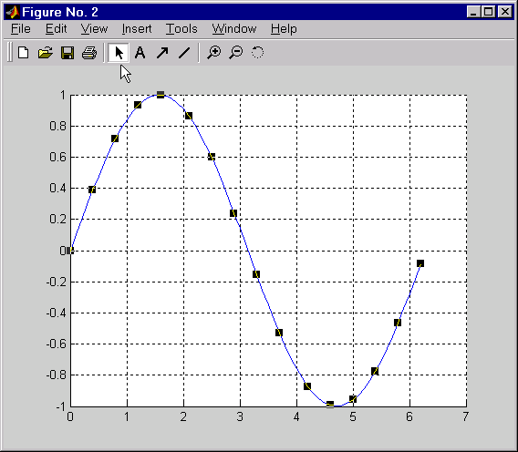
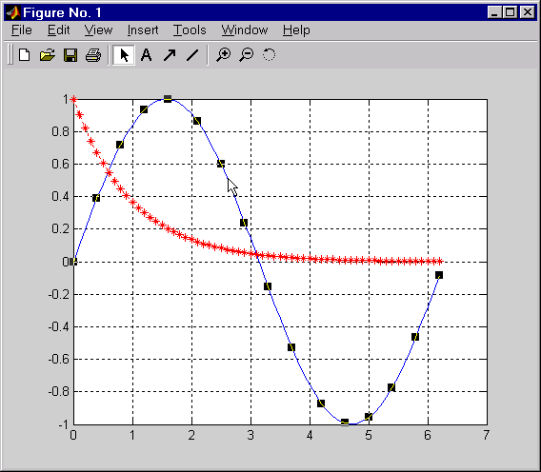
Deleting/Copying the Current Object
Enable the Plot Editor and click on an object (sine wave)
  ctrl-x - cut object
  ctrl-c - copy object
  delete - remove object
Notes:
Deleting/Copying the Current
Object
Using the Plot editing toolbar, you can delete objects from
your plots. Click on the enable plot editing button (to the
right of the print button), and select the object you would
like to delete. Black boxes on the points or corners of the
object tell you that it has been selected. Use the Delete
key, or clear under the edit menu to delete objects. Note
that this cannot be undone.
You can also copy objects to another figure. Enable plot editing, select the object you would like to copy, and use Ctrl+C or Copy from the edit menu. Then create a new figure by clicking on the new figure button, or typing figure at the command prompt. To paste the object you must first enable plot editing in the new figure, then use Ctrl+V or Paste from the edit menu.
Ctrl+X - cut object
Ctrl+C - copy object
Ctrl+V - paste object
Delete - remove object

Slide 17
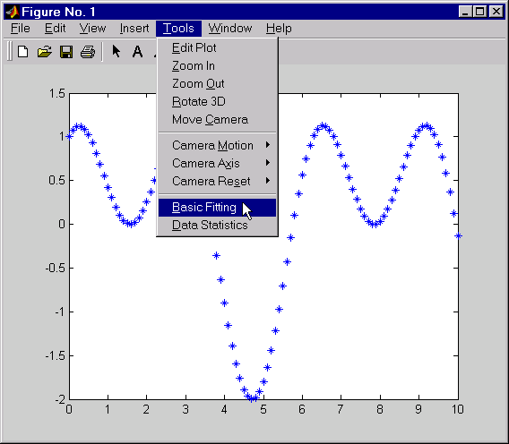
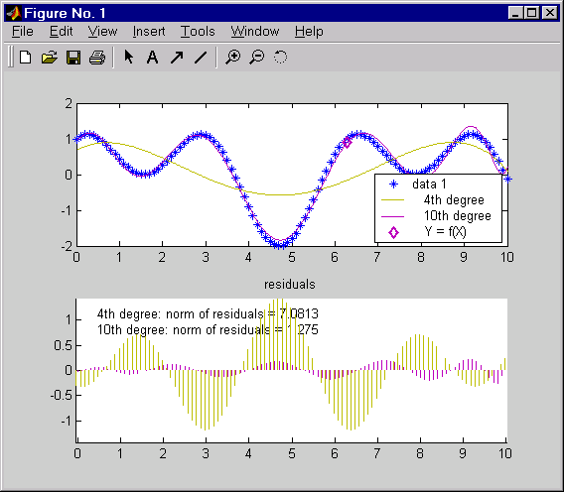
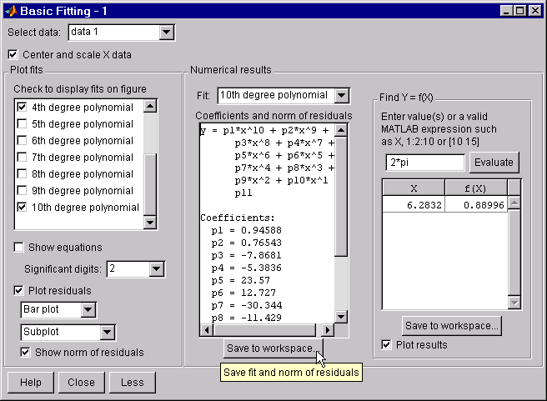
Basic Fitting Tool
Notes:
Basic Fitting Tool
Try:
>> x = 0:0.1:10;
>> y = sin(x)+cos(2*x);
>> plot(x,y,'*')

Slide 18
Basic Fitting Tool
Notes:
Basic Fitting Tool (Continued)
MATLAB supports curve fitting through the Basic Fitting Interface. Using this interface, you can quickly perform basic curve fitting tasks within the same easy-to-use environment. The interface is designed so that you can:
Fit data using a cubic spline or a polynomial up to degree 10.
Plot multiple fits simultaneously for a given data set.
Plot the fit residuals.
Examine the numerical results of a fit.
Evaluate (interpolate or extrapolate) a fit.
Annotate the plot with the numerical fit results and the norm of
residuals.
Save the fit and evaluated results to the MATLAB workspace.
Depending on your specific curve fitting application, you can use the Basic Fitting Interface, the command line functionality, or both.
You can use the Basic Fitting interface only with 2-D data. However, if you plot multiple data sets as a subplot, and at least one data set is 2-D, then the interface is enabled.
For the HP, IBM, and SGI platforms, the Basic Fitting Interface is not supported for Release 12.0.

Slide 19
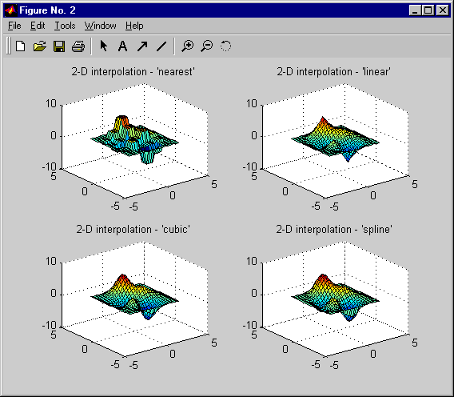
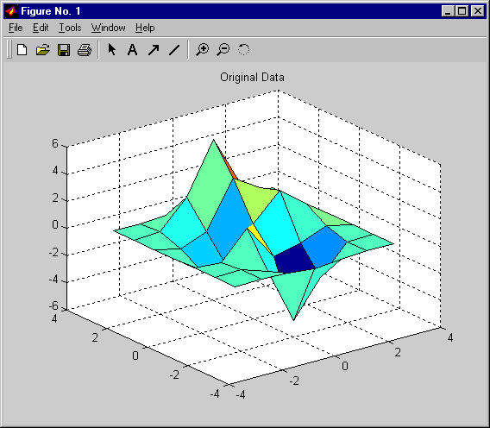
Interpolation of Data
INTERP1() - 1-D interpolation (table lookup)
INTERP2(), INTERP3(), INTERPN() .....
yi = interp1(x, y, xi, method)
>> interp_ex
Notes:
See:
Using MATLAB
Pages:
5-9 - 5-23
Interpolation of Data
Interpolation is a widely used technique for estimating the
a system’s behavior based on a small number of measured
data points. The following basic MATLAB commands are
provided for this purpose:
1-D Interpolation
interp - Basic command for 1-D interpolation (various methods available).
interpq - Quick (linear) method of interpolation.
spline - Cubic spline interpolation.
interpft - FFT-based interpolation.
Multidimensional Interpolation Functions
interp2/griddata - 2-D interpolation.
interp3 - 3-D interpolation.
interpn - Multidimensional interpolation.
Populating a Data Space for Interpolation
meshgrid - Creates rectangular arrays to populate a 2-D area for interpolation.
ndgrid - Creates arrays for multidimensional functions and interpolation.

Slide 20
Example: First Order Linear Fit using “Left Division”
Solve these equations for the slope and intercept:
(y = mx + b)
>> x = [2 1; 3 1; -3 1];
>> y = [12; 17; -5];
>> mb = x\y
mb =
3.5806 %Slope
5.6129 %Intercept
% Now evaluate y = mx + b
>> y_fit = mb(1)*x(:,1) + mb(2)
y_fit =
12.7742
16.3548
-5.1290
12 = m*2 + 1*b
17 = m*3 + 1*b
-5 = m*-3 + 1*b
>> solve_examp2
Notes:
First Order Linear Fit
Left division can also be used to perform a first order
linear fit for your data. In the case above we have three
linear functions in the form
y = mx + b
By adding a column of ones to our “x” data (this column
can be thought of as the coefficients to the intercepts), left
division will give you the slope and intercept of the fitted line for the data.
12 = m*2 + 1*b
17 = m*3 + 1*b ---> b = A*x ---> A\b = x
-5 = m*-3 + 1*b
%This is the A matrix
>> x = [2 1; 3 1; -3 1];
%This is the b matrix
>> y = [12; 17; -5];
%Calculate the x (x = A\b)
>> mb = x\y
mb =
3.5806 %Slope
5.6129 %Intercept
% Now evaluate y = mx + b
>> y_fit = mb(1)*x(:,1) + mb(2)
y_fit =
12.7742
16.3548
-5.1290
The resulting y_fit is not the exact y values we began with, because this is a best fit to the data.
Try:
>> x = [2 1;
3 1;
-3 1];
>> y = [12;
17;
-5];
>> mb = x\y
>> y_fit = mb(1)* ...
x(:,1) + mb(2)

Slide 21
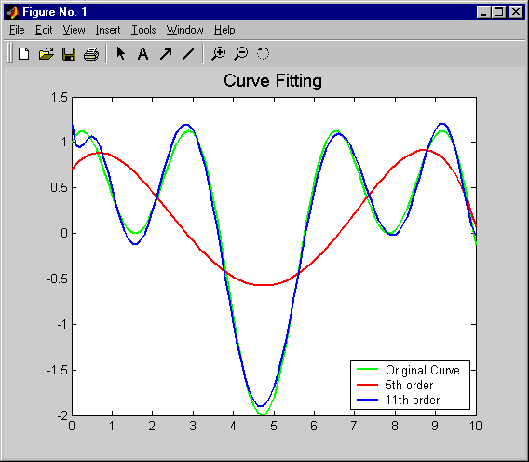
Polynomial Fitting
POLYFIT - Fitting polynomial to data
POLYVAL - Evaluate polynomial
Left Division
>> x = 0:.1:10;
>> y = sin(x)+cos(2*x);
>> k5 = polyfit(x,y,5);
>> y5 = polyval(k5, x);
>> k11 = polyfit(x,y,11);
>> y11 = polyval(k11, x);
>> plot(x, y, 'g',...
x, y5, 'r',...
x, y11,'b')
>> curve_fit
Ref: Optimization Toolbox
Notes:
Polynomial Fitting
polyfit is used to fit polynomials to pairs of x- & y-data.
polyfit is used to evaluate polynomials.
>> x = 0:.1:10;
>> y = sin(x)+cos(2*x);
>> k5 = polyfit(x,y,5);
>> y5 = polyval(k5, x);
>> k11 = polyfit(x,y,11);
>> y11 = polyval(k11, x);
>> plot(x, y, 'g', x, y5, 'r', x, y11,'b')
Left division can be used to fit data to a very wide variety of
linear models. This type of problem uses the following approach.
Single Variable Model (x), Linear-in-the-Parameters
Given x and y column vectors, solve for the coefficients in the equation.
y = a + b*x^3 + c*log(x) + d*sqrt(x);
Set up a model matrix (each column represents separate term in equation).
A = [ones(size(x)), x.^3, log(x), sqrt(x)];
Multiple Regression Problem
Given x1, x2 and y (where y is a function of both x1 and x2), solve for the coefficients.
y = a + b*x1 + c*x2 + d*x1.*x2 + e*x1.^2./x2;
Ak = y ---> k = A\y
Set up a model matrix (each column represents separate term in equation).
A = [ones(size(x)),x1,x2,x2.*x2,x1.^2./x2];
See:
Using MATLAB
Pages:
5-2 - 5-8

Slide 22
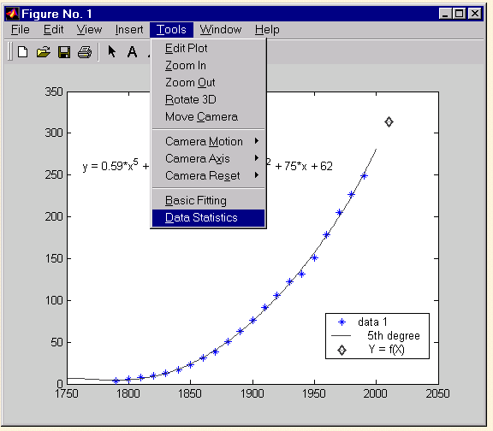
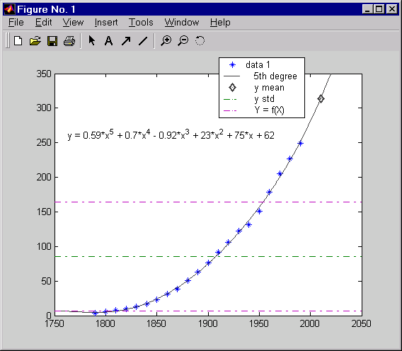
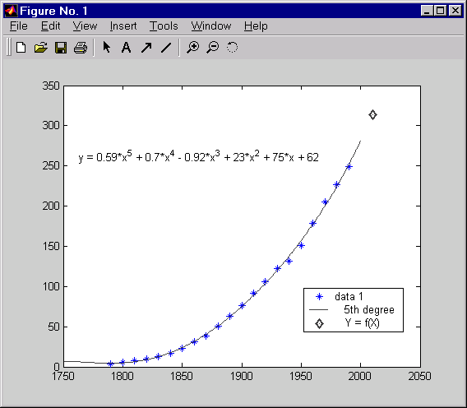
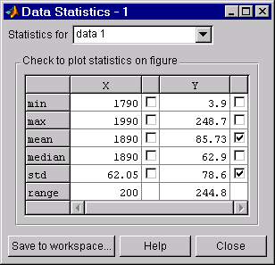
Data Statistics Tool
>> load census
>> plot(cdate,pop,’*’)
Notes:
Data Statistics Tool
Try:
>> load census
>> plot(cdate,pop,’*’)

Slide 23
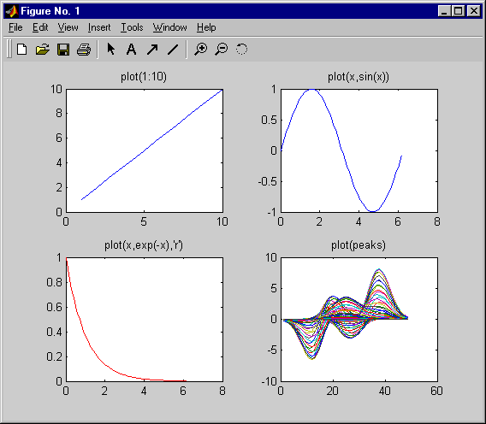
Subplots
SUBPLOT- display multiple axes in the same figure window
subplot(#rows, #cols, index)
>> subplot(2,2,1);
>> plot(1:10)
>> subplot(2,2,2)
>> x = 0:.1:2*pi;
>> plot(x,sin(x))
>> subplot(2,2,3)
>> x = 0:.1:2*pi;
>> plot(x,exp(-x),’r’)
>> subplot(2,2,4)
>> plot(peaks)
>> subplotex
Notes:
See:
Using MATLAB Graphics
Pages: 2-3 - 2-6
Subplots
You can display multiple plots in the same window with
the subplot command.
>> subplot(m, n, p)
The above call to subplot will divide the current figure
window into an m-by-n matrix of small subplots. The pth subplot will be the current plot. The plots are numbered along first the top row of the figure window, and then the second row, and so on. For example, the following statement will display an axes in the upper left hand corner of the figure window:
>> subplot(2,2,1)
And the following statement, will display an axes in the lower left hand corner of the figure window:
>> subplot(2,2,3)
Try:
>> subplot(2,2,1);
>> plot(1:10)
>> subplot(2,2,2)
>> x = 0:.1:2*pi;
>> plot(x,sin(x))
>> subplot(2,2,3)
>> x = 0:.1:2*pi;
>> plot(x, ...
exp(-x),’r’)
>> subplot(2,2,4)
>> plot(peaks)

Slide 24
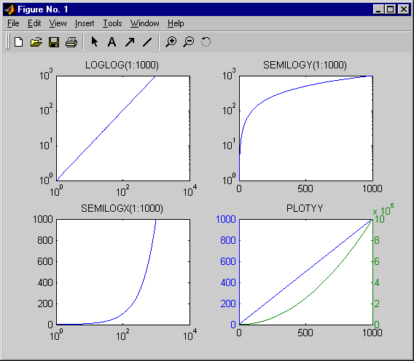
Alternative Scales for Axes
LOGLOG
Both axes
logarithmic
SEMILOGY
log Y
linear X
SEMILOGX
log X
linear Y
PLOTYY
2 sets of
linear axes
>> other_axes
Notes:
Alternative Scales for Axes
MATLAB provides a variety of functions for displaying
data as 2-D graphs. The following functions all produce
basic line plots of data, differing only in the way they scale
the plot axes. Each accepts input in the form of vectors or
matrices and automatically scales the axes to accommodate
the input data.
plot - creates a plot of vectors or columns of matrices.
loglog - creates a plot using logarithmic scales for both axes.
semilogy - creates a plot using a logarithmic scale for the x-axis and a linear scale for the y-axis.
semilogy - creates a plot using a logarithmic scale for the y-axis and a linear scale for the x-axis.
plotyy - creates a plot of two independent sets of data with separate vertical scales.
Try:
>> help loglog
>> help semilogx
>> help semilogy
>> help plotyy
>> other_axes
loglog
both axes
logarithmic
semilogx
log X
linear Y
plotyy
2 sets of
linear axes
semilogx
linear X
log Y

Slide 25
Exercise 3.2: Polynomial Fitting
Begin by loading the temperature data.
  >> load temperature
Use the basic fitting tools to fit a polynomial to our temperature data.
Save the coefficients to the workspace as a structure.
You can also do this using POLYFIT.
What happens as you fit the data using higher order polynomials?
Notes:
Exercise 3.2: Polynomial Fitting
Begin by loading the temperature data.
>> load temperature
Use the basic fitting tools to fit a polynomial to our
temperature data.
Save the coefficients to the workspace as a structure.
You can also do this using polyfit.
What happens as you fit the data using higher order polynomials?
First:
>> load temperature

Slide 26
Solution appears on following page.
Notes:
Solution appears on following page.

Slide 27
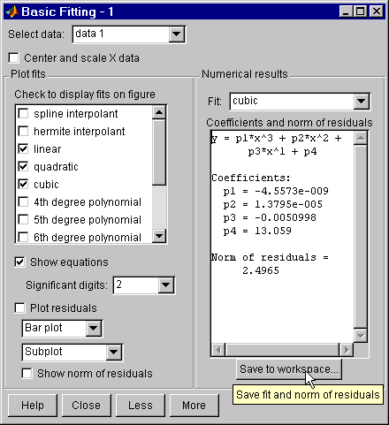
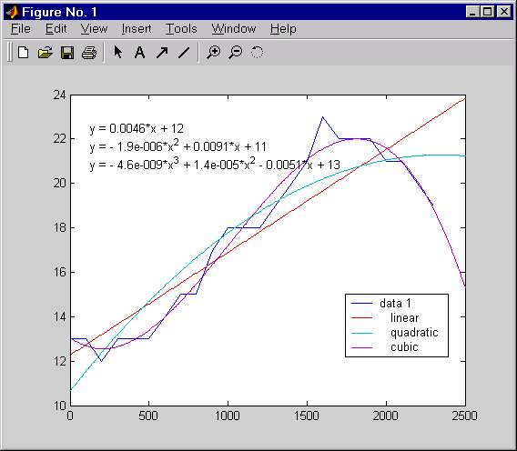
Solution 3.2: Polynomial Fitting
Notes:
Results: Polynomial Fitting

Slide 28
Solution 3.2: Polynomial Fitting
load temperature %Load temperature data
plot(time, temp) %Plot
hold on
k2 = polyfit(time,temp,2); %Second order fit
ft2 = polyval(k2,time); %Evaluate polynomial
plot(time, ft2, 'r') %Plot
k4 = polyfit(time,temp,4); %Fourth order fit
ft4 = polyval(k4,time); %Evaluate polynomial
plot(time, ft4, 'k') %Plot
xlabel('Time (hours)')
ylabel('Temperature (degrees F)')
title('Temperature change for typical February day')
legend('Temperature Data', 'Second Order Fit', ...
'Fourth Order Fit', 2)
>> curvefit_soln (uses: temperature.mat)
Notes:
Solution 3.2: Polynomial Fitting
load temperature %Load temperature data
plot(time, temp) %Plot
hold on
k2 = polyfit(time,temp,2); %Second order fit
ft2 = polyval(k2,time); %Evaluate polynomial
plot(time, ft2, 'r') %Plot
k4 = polyfit(time,temp,4); %Fourth order fit
ft4 = polyval(k4,time); %Evaluate polynomial
plot(time, ft4, 'k') %Plot
xlabel('Time (hours)')
ylabel('Temperature (degrees F)')
title(['Temperature change for typical' ...
' February day'])
legend('Temperature Data', ...
'Second Order Fit','Fourth Order Fit', 2)
Try:
>> edit cuvefit_soln
>> curvefit_soln

Slide 29
Solution 3.2: Polynomial Fitting
(Continued)
What happens if an order higher than 2 is used?
  You get a warning message
This occurs when attempting to take the inverse of a matrix that is close to singular (not invertable).
It may be that we are using too high an order polynomial to fit this data:
  Imagine what would happen if we tried to use a sledge hammer to hang a picture.
>> k5 = polyfit(time,temp,5)
Warning: Polynomial is badly conditioned. Remove repeated data points
or try centering and scaling as described in HELP POLYFIT.
> In C:\MATLABR12\toolbox\matlab\polyfun\polyfit.m at line 74
>> curvefit_soln (uses: temperature.mat)
Notes:
Solution 3.2: Polynomial Fitting (Continued)
What happens if an order higher than 2 is used?
You get a warning message.
>> k5 = polyfit(time,temp,5)
Warning: Polynomial is badly conditioned. Remove repeated
data points or try centering and scaling as described
in HELP POLYFIT.
> In C:\MATLABR12\toolbox\matlab\polyfun\polyfit.m at line 74
This warning indicates that your results may be inaccurate. This occurs when attempting to take the inverse of a matrix that is close to singular (not invertable). These warning messages sometimes result when solving a linear system. When step sizes are small enough, these warnings are generated because the system is linearly dependant. However in this case these warning messages can be ignored because the polyfit algorithm self-corrects (or stops) when the step size gets too small.
It may be that we are using too high an order polynomial to fit this data. Imagine what would happen if we tried to use a sledge hammer to hang a picture.

Slide 30
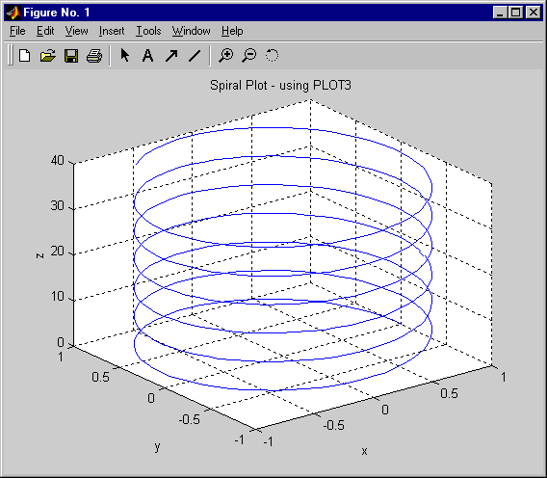
3-D Line Plotting
plot3(xdata, ydata, zdata, 'clm', ...)
>> z = 0:0.1:40;
>> x = cos(z);
>> y = sin(z);
>> plot3(x,y,z)
>> plot_3d
Ref: Color, Linestyle, Marker options
Notes:
3-D Line Plotting
plot3(xdata, ydata, zdata, 'clm', ...)
plot3d can be used to create line plots of 3-D vectors.
The syntax is similar to the plot command, with the
addition of an input argument for the z-data (representing
the height above the x-y plane). The the color, linestyle
and marker type are specified in the same way as for the
2-D command.
>> z = 0:0.1:40;
>> x = cos(z);
>> y = sin(z);
>> plot3(x,y,z)
Utility Commands for 3-D Plotting
zlabel - creates a label for the z-axis.
rotate3d - allows the user to rotate the plot to view from different angles (Default angle: Azimuth: -38°, Elevation: 30°)
axis vis3d - freezes aspect ratio properties to enable rotation of 3-D object.
comet3 - produces a comet-like trajectory of 3-D data points.
Try:
>> z = 0:0.1:40;
>> x = cos(z);
>> y = sin(z);
>> plot3(x,y,z)
>> help comet3
>> comet3(x,y,z)
% look at the
% current figure

Slide 31
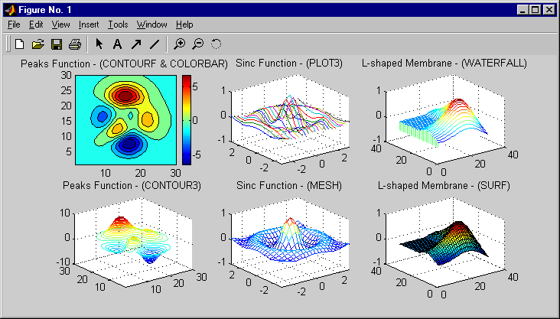
3-D Surface Plotting
>> surf_3d
Notes:
3-D Surface Plotting
MATLAB provides a variety of functions for representing
3-D surface data. The following list summarizes these
functions.
contour - creates a 2-D representation of 3-D
surface data. The third dimension is represented by
the contour lines (join points of equal height) and colormap.
contour3 - creates a 3-D version of the contour plot.
plot3 - plots 3-D lines representing the data contained in the columns of the input matrices. Each line is given a different color.
mesh - creates 3-D perspective plots of matrix elements, displayed as height above a reference plane. It generates a colored, wire-framed view of the surface.
waterfall - plots 3-D lines representing the data contained in the rows of the input matrices. Each line is joined to the reference plane creating a “curtain plot.”
surf - creates 3-D perspective plots of matrix elements, displayed as height above an underlying plane. It generates a colored, faceted view of the surface.
Try:
>> help contour
>> help contour3
>> help plot3
>> help mesh
>> help waterfall
>> help surf
>> edit surf_3d
>> surf_3d

Slide 32
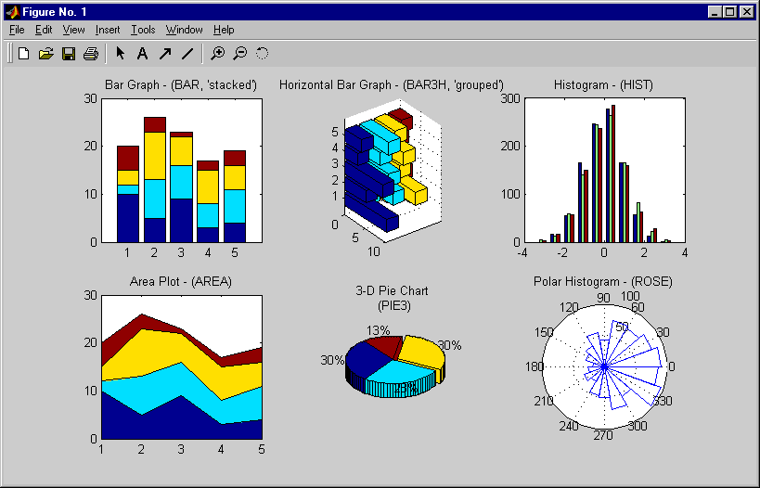
Specialized Plotting Routines
>> spec_plots
Notes:
See:
Using MATLAB Graphics
Pages:
Chapter 4
Specialized Plotting Routines
The commands in the script spec_plots were used to
generate the figure shown below: The commands used for
each plot can be found in the title.
Try:
>> help bar
>> help bar3h
>> help hist
>> help area
>> help pie3
>> help rose
>> edit spec_plots
>> spec_plots

Slide 33
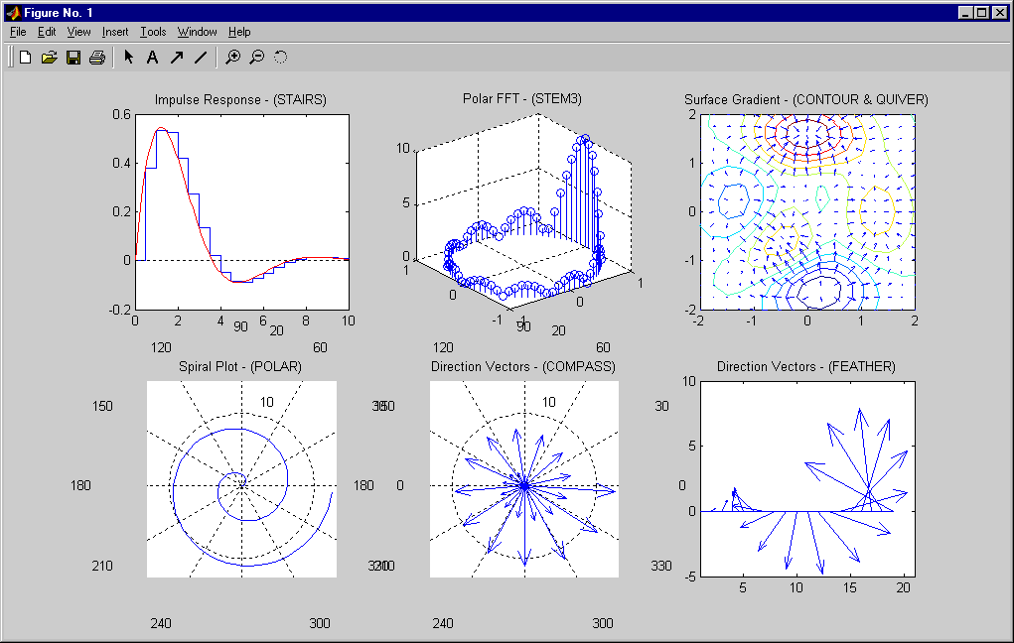
Specialized Plotting Routines (2)
>> spec_plots2
Notes:
See:
Using MATLAB Graphics
Pages:
Chapter 4
Specialized Plotting Routines
(Continued)
The commands in the script spec_plots2 were used to
generate the figure shown below: The commands used for
each plot can be found in the title.
Try:
>> help stairs
>> help stem3
>> help contour
>> help quiver
>> help polar
>> help compass
>> help feather
>> edit spec_plots2
>> spec_plots2

Slide 34
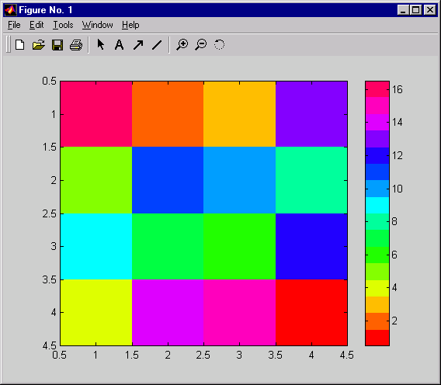
Images
Reduced Memory Requirements:
Images represented as UINT8 - 1 byte
>> a = magic(4)
a =
16 2 3 13
5 11 10 8
9 7 6 12
4 14 15 1
>> image(a);
>> map = hsv(16)
map =
1.0000 0 0
1.0000 0.3750 0
1.0000 0.7500 0 .....
>> colormap(map)
Use Row 2 of colormap for pixel (1,2)
Row 2
>> imagex
Notes:
See:
Using MATLAB Graphics
Pages:
Chapter 5
Images
>> a = magic(4)
a =
16 2 3 13
5 11 10 8
9 7 6 12
4 14 15 1
>> image(a);
>> map = hsv(16)
map =
1.0000 0 0
1.0000 0.3750 0
1.0000 0.7500 0 .....
>> colormap(map)
image uses integer data that ranges from 1 to N, where
N is the length of the colormap. Each element of the image
is a direct index into the color map. For example,
>> a = magic(4)
a =
16 2 3 13
5 11 10 8
9 7 6 12
4 14 15 1
Element (1,2) is 2, therefore, the second row of the colormap is used to color the rectangular patch associated with (1,2). If the data is less than 1, it is mapped to the first row, and if the data exceeds the limits of the colormap, it is mapped to the last tow of the colormap. If noninteger data is used with IMAGE, the information to the right of the decimal is ignored. Images can now be represented as either double-precision floating point (8 bytes) or as unsigned 8-bit integer (UINT8 - 1 byte).
imagesc - scales your data to use the full range of the colormap.
Try:
>> help image
>> a = magic(4)
>> image(a);
>> map = hsv(16)
>> colormap(map)
%or
>> imagex
>> help imagesc

Slide 35
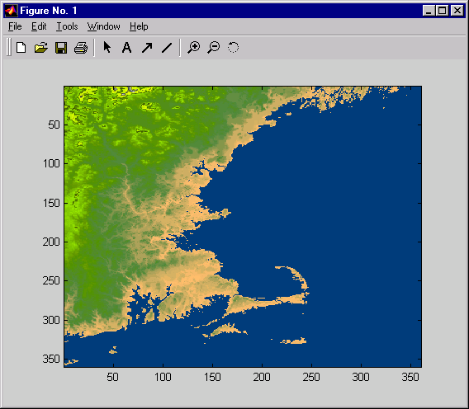
Example: Images
The MathWorks
>> load cape
>> image(X)
>> colormap(map)
>> draw_cape
Notes:
Example: Images
The data for this picture was obtained from the NOAA
(National Oceanic and Atmospheric Administration) and
was plotted with an appropriate colormap using the image command.
(Pseudocolor map uses blue for zero altitude.)
Try:
>> load cape
>> whos
>> image(X)
>> colormap(map)
% or
>> draw_cape

Slide 36
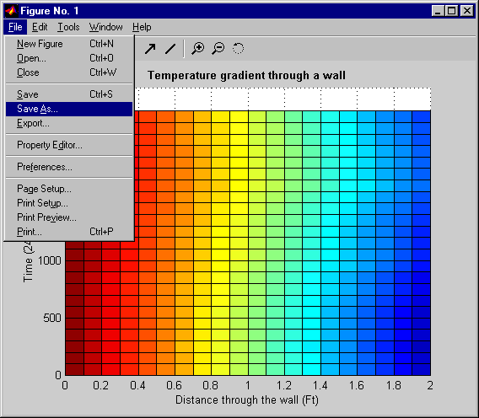
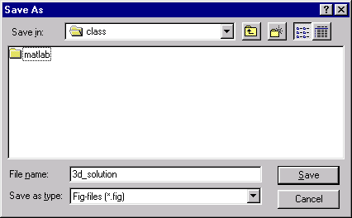
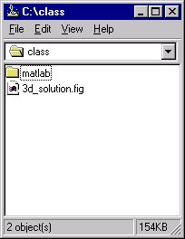
Saving Figures
1 file created:
*.fig - binary data file
>> plot3d_soln
Notes:
Saving Figures
You can save figures with Save or
Save As through the File menu on the
figure window. This will create a .fig file.
The .fig file is a binary file containing all the
information that describes the figure. This format
is used by MATLAB, and allows you to work on
the same figure during a later session.
To open a .fig file, type
>> open('3d_solution.fig')

Slide 37
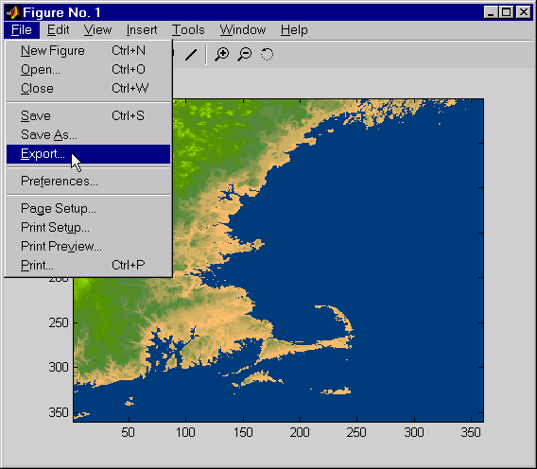
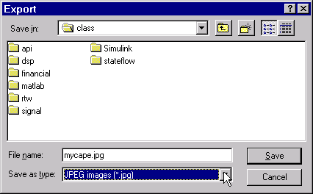
Exporting Figures to Files
Some supported formats:
JPEG images (*.jpg)
Bitmap files (*.bmp)
TIFF images (*.tif)
EPS files (*.eps)
etc. …
Notes:
Exporting Figures to Files
Figures can be exported to the below listed formats using the File-Export menu from the figure window. File formats supported are
Enhanced meta-file (*.emf)
Bitmap file (*.bmp)
EPS files (*.eps)
EPS color files (*.eps)
EPS Level 2 (*.eps)
EPS Level 2 color (*.eps)
Adobe Illustrator Files (*.ai)
JPEG Images (*.tif)
TIFF Images (*.tif)
TIFF No Compression Images (*.tif)
Portable Network Graphics (*.png)
Paintbrush 24-bit files (*.pcx)
Portable bitmap files (*.pbm)
Portable graymap files (*.pgm)
Portable Pixmap files (*.ppm)
MATLAB supports additional graphic formats via the print command. Type help print for more options.
Try:
>> help print

Slide 38
Exporting Figures - from the Command Line
Use PRINT to Create a hardcopy output
Syntax:
PRINT alone sends the current figure to your current printer:
  >> print
To specify a print device (i.e., an output format such as tiff or PostScript or a print driver that controls what is sent to your printer):
  >> print -device
  >> print -device -options
Specify a filename to direct the output to a file instead of a printer:
  >> print -device -options filename
PRINTOPT is an M-file that you or your system manager can edit to indicate your default printer type and destination. When called, it returns the defaults:
  >> [pcmd,dev] = printopt
>> help print
>> help printopt
Notes:
Exporting Figures
From the Command line - Supported File Formats
The following formats are supported by using PRINT from
the command line. The syntax is
print -device -options filename
Both UNIX and PC Formats:
EPS (MATLAB) black and white -deps
EPS (MATLAB) color -depsc
EPS (MATLAB) Level 2 black&white -deps2
EPS (MATLAB) Level 2 color -depsc2
ILL (Adobe Illustrator) (MATLAB) -dill
JPEG (MATLAB) 24-bit -djpeg
PNG (MATLAB) 24-bit -dpng
TIFF (MATLAB) 24-bit -dtiff or -dtiffn
TIFF preview for EPS Files -tiff
Only valid for EPS files.
PC Only Formats:
BMP (Ghostscript) 24-bit BMP -dbmp16m
BMP (Ghostscript) 8-bit (256-color) BMP *this
format uses a fixed colormap -dbmp256
BMP (MATLAB) 24-bit -dbmp
EMF (MATLAB) -dmeta
HDF (MATLAB) 24-bit -dhdf
PCX (Ghostscript) 1-bit -dpcxmono
PCX (Ghostscript) 24-bit color PCX file
format, three 8-bit planes -dpcx24b
PCX (Ghostscript) 8-bit Newer color PCX file
format (256-color) -dpcx256
PCX (Ghostscript) Older color PCX file format
(EGA/VGA, 16-color) -dpcx16
PCX (MATLAB) 8-bit -dpcx
UNIX Only Formats:
PBM (Ghostscript) (plain format) 1-bit -dpbm
PBM (Ghostscript) (raw format) 1-bit -dpbmraw
PGM (Ghostscript) Portable Graymap (plain format) -dpgm
PGM (Ghostscript) Portable Graymap (raw format) -dpgmraw
PPM (Ghostscript) Portable Pixmap, plain format -dppm
PPM (GhostScript) Portable Pixmap raw format -dppmraw
PPM (GhostScript) Portable Pixmap, plain format -dpcx24b
printopt is an M-file that you or your system manager can edit to indicate your default printer type and destination. When called, it returns the defaults
>> [pcmd,dev] = printopt
Try:
>> help print
>> help printopt
See:
Using MATLAB Graphics
Pages:
Chapter 7

Slide 39
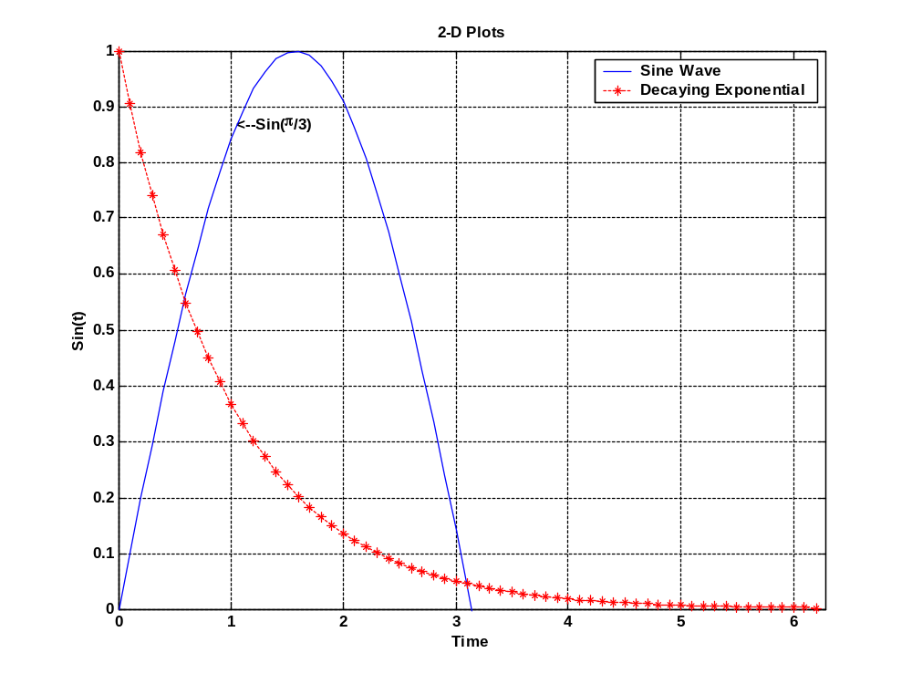
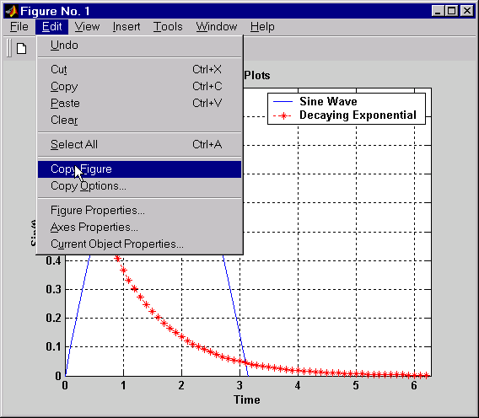
Copying to Clipboard
Copying to Clipboard:
Options:
(Edit / Copy Options)
Copying:
(Edit / Copy Figure)
Notes:
Copying to Clipboard
This plot was copied into Power Point using Copy Figure from the Edit menu.

Slide 40
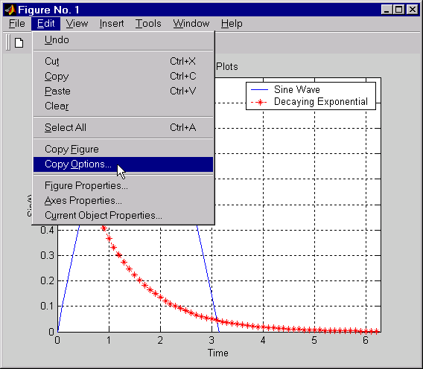
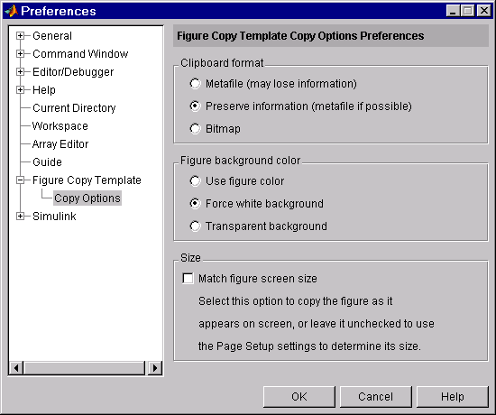
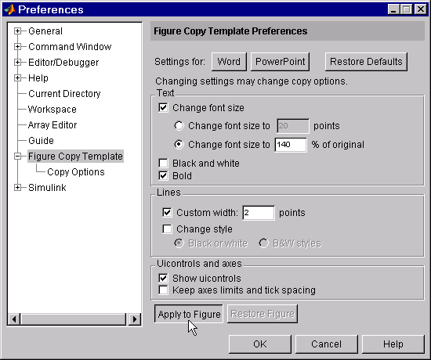
Copy Options
Notes:
Copy Options
Through the Edit/Copy Figure menu
MATLAB graphics can be copied into
other applications. Copy options
customize the properties of the figure
for the best possible display in other
environments.
The figure copy template allows
defaults to be set for the following
items.
Application, text, line, uicontrols, axis,
format, background color, and size

Slide 41
Introduction to Handle Graphics®
Graphics in MATLAB consist of objects
Every graphics objects has a unique handle and a set of properties which define it’s appearance.
Objects are arranged in terms of a set hierarchy
Root (screen)
Figure
Axes
Uicontrol
Uimenu
Uicontextmenu
Image
Light
Line
Patch
Rectangle
Surface
Text
Notes:
See:
Using MATLAB Graphics
Pages:
Chapter 8
Introduction to
Handle Graphics®
Graphics in MATLAB consist of objects.
Every graphics objects has a unique handle and a set of
properties that define its appearance.
Objects are arranged in terms of a set hierarchy.

Slide 42
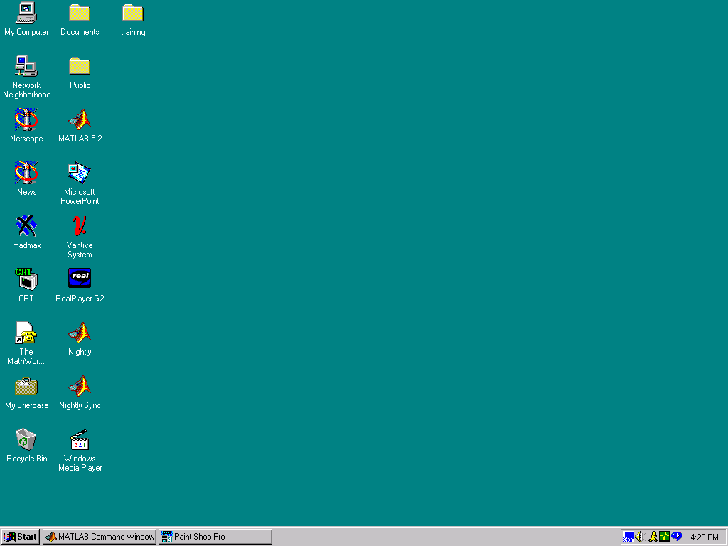
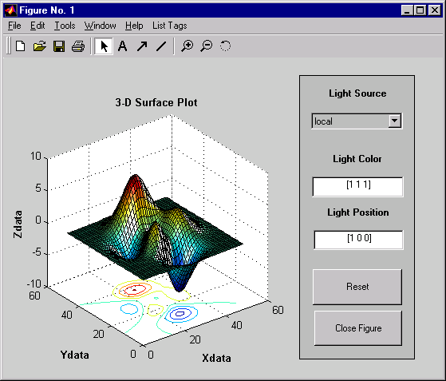
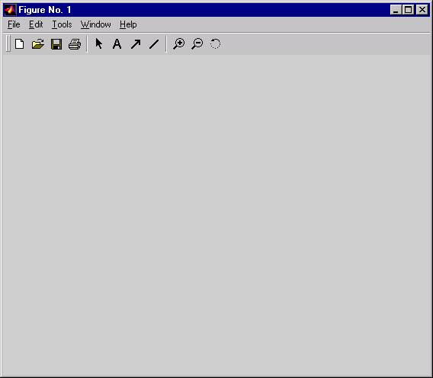
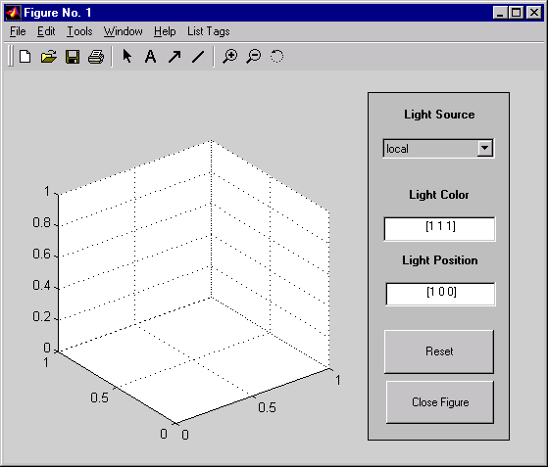
Hierarchy of Graphics Objects
Root
object
UIMenu
objects
Figure
object
UIControl
objects
Surface
object
Axes object
Line
objects
Text
object
Notes:
Hierarchy of Graphics Objects
Surface
object
Line
objects
Text
object
Reference Documentation: link to the on-line doc for hierarchy

Slide 43
Obtaining an Object’s Handle
1. Upon Creation
2. Utility Functions
    0 - root object handle
    gcf - current figure handle
    gca - current axis handle
    gco - current object handle
3. FINDOBJ and FINDALL
h_line = plot(x_data, y_data, ...)
What is the current object?
Last object created
OR
Last object clicked
h_obj = findobj(h_parent, 'Property', 'Value', ...)
h_all = findall(h_parent, ...)
Default = 0 (root object)
Notes:
Obtaining an Object’s Handle
To manipulate the appearance of a graphics object, you
must have the handle to that graphics object. There are
three methods for obtaining the handle to an object:
1. Defining the handle variable at the time the graphics
object is created
h_line = plot(x_data, y_data, ...)
2. Using MATLAB commands that access object handles
0 - root object handle
gcf - current figure handle
gca - current axis handle
gco - current object handle
(The current object is last object created or last object clicked)
3. Using the findobj or findall command, which searches all existing handles
h_obj=findobj(h_parent, 'Property', 'Value')
h_all=findall(h_parent, ...)
(The default for h_parent is 0 (root object))
An object’s parent is always one level up the graphics object hierarchy.
For example,
root parent of… figures,
figure parent of… axes,
axes parent of… lines, etc.
There are two utility functions that are used in the creation of GUI’s.
gcbf - Get handle to current callback figure
gcbo - Get handle to current callback object
Try:
>> x = 0:.1:10;
>> y = sin(x);
%get handle at
%creation
>> h = plot(x,z)
>> h0 = ...
title(‘Sine(T)’)
>> h1 = ...
xlabel(‘Time’)
>> h2 = ylabel(‘M’)
%utility functions
>> help gcf
>> help gca
>> help gco
>> help findobj
>> help findall
>> ln = ...
findobj(0, ...
‘Type’,’Line’)
>> htxt = ...
findall( ...
gcf,’type’,’text’)
>> help gcbf
>> help gcbo

Slide 44
Modifying Object Properties
Using GET & SET
Obtain a list of current properties:
Obtain a list of settable properties:
Get an objects property:
Modify an object’s properties:
get(h_object) -- get(gca)
set(h_object) -- set(gcf)
get(h_object, 'PropertyName')
get(gcf, 'Color')
set(h_object, 'PropertyName', 'New_Value')
set(gca, 'XDir' 'Reverse')
Ref: Help Browser - Full Text search for “Graphics Object Hierarchy”
Notes:
See:
Using MATLAB Graphics
Pages:
8-15 - 8-19
Modifying Object Properties
Using GET & SET
These are the basic ways in which the get and set
commands are used for modifying object properties.
Obtain a list of current properties
get(h_object)
>> get(gca)
Obtain a list of settable properties
set(h_object)
>> set(gcf)
Get an object’s property
get(h_object, 'PropertyName')
>> get(gcf, 'Color')
Modify an object’s properties
set(h_object, 'PropertyName', 'New_Value')
>> set(gca, 'XDir' 'Reverse')
The helpbrowser contains a hierarchical breakdown of the properties belonging to each graphics object. To view this hierarchy, open the Help browser by typing helpbrowser at the MATLAB prompt. Then use the Full Text search for “Graphics Object Hierarchy.”
Try:
>> x = 0:0.1:2*pi;
>> h = ...
plot(x,exp(-x));
>> get(h)
>> set(h)
>> c = ...
get(h,’Color’)
>> set(h, ...
’Color’,’r’)
>> set(h, ...
’Marker’,’*’)

Slide 45
Handle Graphics Property Editor
Enable plot editing
  By clicking the plot editing icon in the figure window toolbar
  >> plotedit
To activate the Property Editor
  Double-clicking on a graphic object in the figure
  Right mouse click on an object & select “Properties”
  >> propedit
Notes:
Handle Graphics Property Editor
To enable plot editing, click the plot editing icon in the figure window toolbar.
>> plotedit
To activate the Property Editor:
Double-click on a graphics object in the figure
or
Right-click on an object and select Properties.
>> propedit

Slide 46
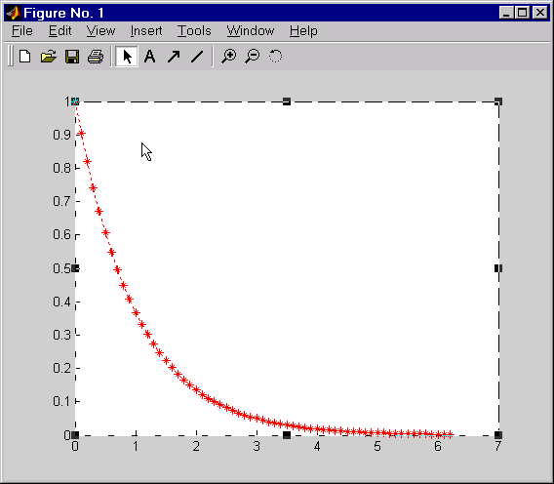
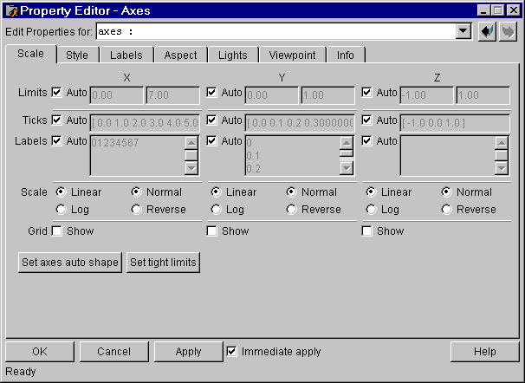
HG Property Editor — Axis
Tree of objects
Edited objects
Help for object
Notes:
HG Property Editor – Axis
Try:
>> propedit

Slide 47
Working with Defaults – Setting
Most properties have pre-defined 'factory' values
(Used whenever property values are not specified.)
You can define your own 'default' values to be used for creating new objects.
(Put default settings in “startup.m” to apply to whole session)
Syntax:
set(ancestor,'Default<Object><Property>',<Property_Val>)
Use root object (0) to apply to all new objects
Notes:
Working with Defaults – Setting
Most properties have pre-defined “factory” values. The are
used whenever property values are not specified.
You can define your own default values to be used for
creating new objects. (Put default settings in startup.m
to apply to whole session.)
Syntax:
set(ancestor,'Default<Object><Property>',<Property_Val>)
Use root object (0) as the ancestor to apply to all new objects.

Slide 48
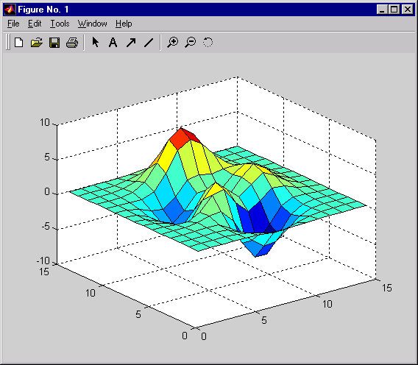


Example: Working with Defaults
Set the Default Surface EdgeColor to Blue & create new surface.
>> set(0, 'DefaultSurfaceEdgeColor', 'b')
>> h=surf(peaks(15));
Set the EdgeColor to Green
>> set(h, 'EdgeColor', 'g')
Reset back to Default Value
>> set(h, 'EdgeColor', 'default')
specifies Default value
Reset or Remove Value
>> set(h, 'EdgeColor', 'factory')
>> set(h, 'EdgeColor', 'remove')
defaults
Notes:
See:
Using MATLAB Graphics
Pages:
8-20 - 8-25
Example: Working with Defaults
All object properties have default values built into
MATLAB (i.e., factory-defined values). You can also
define your own default values at any point in the object
hierarchy. MATLAB's search for a default value begins
with the current object and continues through the object's
ancestors until it finds a user-defined default value or until it reaches the factory settings.
The closer to the root of the hierarchy you define the default value, the broader is its scope. If you specify a default value for line objects on the root level, MATLAB uses that property value for all lines created in that MATLAB session. (This will apply to objects created with the line command.) If you specify a default value for line objects on the axes level, then MATLAB uses that property value for line objects drawn only in that axes. If you define default values on more than one level, the value defined on the closest ancestor takes precedence since MATLAB terminates the search as soon as it finds a value.
Setting the default values affects only those objects created after you set the default. Existing graphics objects are not affected. Set defaults in startup.m to apply to all objects created.
The set command is used with the following syntax to define a default property value.
set(ancestor,'Default<Object><Property>',<Property_Val>)
For example, suppose you would like all figure windows to be created with a width of 200 pixels, a height of 300 pixels and a x-, y-location of (100,200). The following statement will set the default figure position.
>> set(0, 'DefaultFigurePosition', [100 200 200 300])
Try:
% Set the Default
% Surface EdgeColor
% to Blue & create
% new surface.
>> set(0, ...
['DefaultSurface’ ...
‘EdgeColor’], 'b')
>> h = ...
surf(peaks(15));
% Set the EdgeColor
% to green
>> set(h, ...
'EdgeColor', 'g')
% Reset back to
% default value
>> set(h, ...
'EdgeColor', ...
'default')
% Reset or
% Remove Value
>> set(h, ...
'EdgeColor', ...
'factory')
>> set(h, ...
'EdgeColor', ...
'remove')

Slide 49
Section Summary
2-D plotting
Graph Annotation
Subplots & Alternative Axes
3-D plotting
Specialized plotting routines
Images
Saving & Exporting Figures
Introduction to Handle Graphics
Ref: Color, Linestyle, Marker options
Special characters using LaTeX
Notes:
Section Summary
2-D Plotting
Graph Annotation
Subplots & Alternative Axes
3-D Plotting
Specialized Plotting Routines
Images
Saving & Exporting Figures
Introduction to Handle Graphics

Slide 50
Special characters using LaTeX
Notes:
Special Characters Using LaTeX

Slide 51
Special characters using LaTeX
Notes:
Special Characters Using LaTeX (Continuted)
\bf - bold font
\it - italics font
\sl - oblique font (rarely available)
\rm - normal font
\fontname{fontname} - specify the name of the font to use.
\fontsize{fontsize} - specify the font size in FontUnits.
Subscript and Superscript Characters
The subscript character “_” and the superscript character “^” modify the character or substring defined in braces immediately following.
To print the special characters used to define the Tex strings when Interpreter is Tex, prefix them with the backslash “\” character: \\, \{, \} \_, \^.
When Interpreter is none, no characters in the String are interpreted, and all are displayed when the text is drawn.

